Slide 1
EECS 649 Group Project 2:
QuickDraw!
An A-grade project attempt
Rohan, Shuai, Max, Saharsh

Slide 2
Project Goal
Purpose: Get hands-on experience with Classification problems using a Deep Neural Network
Motivation: Enhance knowledge in the field of Artificial Intelligence and get hands-on practice
Using the QuickDraw! dataset from Google containing a broad variety of drawn objects done by real persons in a limited amount of time using an online interface
Goal: Classify the images

Slide 3
Project Overview
We developed three models:
k-NN
MLP Classifier
Convolutional Neural Network using Python and Tensorflow/Keras: Developed with Google Colab

Slide 4
Project Approach
Understanding the dataset
Clean and split the dataset for validation
Transform the data to fit a model
Train, compile and test

Slide 5
The Dataset
The dataset was obtained from https://quickdraw.withgoogle.com/
Used Categories: axe, banana, bench, hexagon, knife, line, pencil, skull, triangle
Output: Image Category
9 categories w/ 1.5 million drawings in total
Clean Dataset

Slide 6
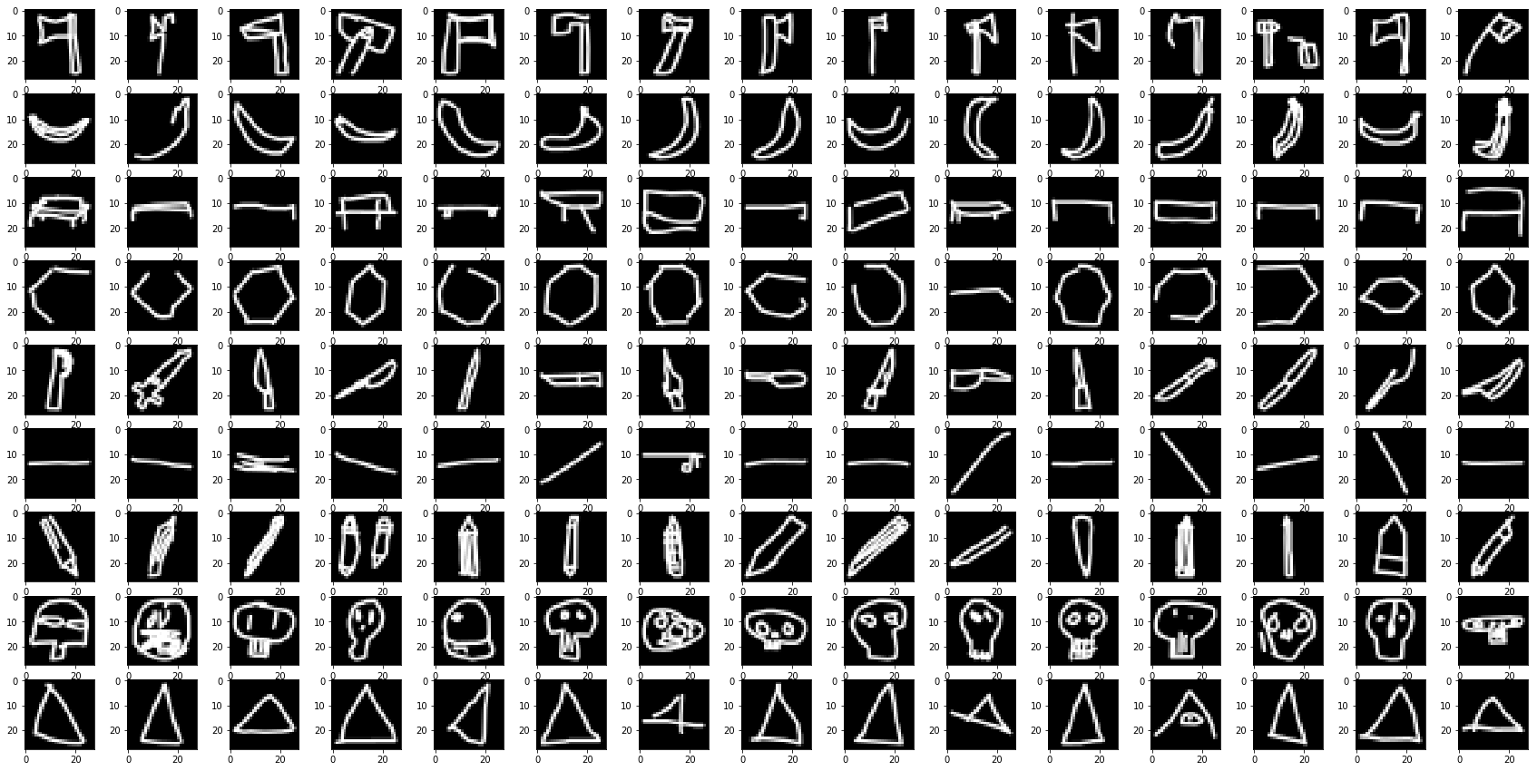
The Dataset

Slide 7
Train, Test and Validation data split
k-NN & MLP Classifier
80% trainset, 20% test set
Convolutional Neural Network
80% train set, 20% test set
k-fold cross-validation w/ k=5

Slide 8
k-NN
accuracy of 89.6%

Slide 9
MLP Classifier
accuracy of 82.4%

Slide 10
Convolutional Neural Network
Transforming input
  The images are available in grey scale (0-255, 8-bit) in a 756-dimensional vector
  Resizing to a 28x28 matrix to input to the network
CNN-architecture:
  4x(conv-layer + dropout) & 2x(dense-layer + dropout)
  in total over 3,451,497 trained parameters
  trained on 10 epochs w/ a batch size of 1024 for each cross-validation

Slide 11
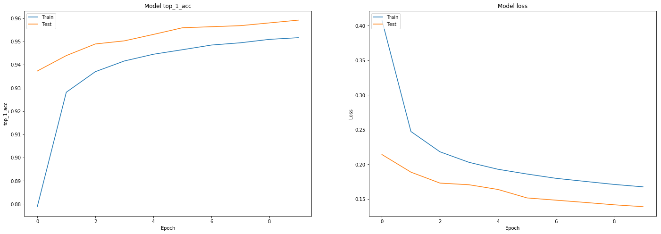
Neural Network Results
~3.5 million trainable parameters
93% top-1 accuracy
98% top-3 accuracy

Slide 12
Deliverables & Requirements (A-grade project)
Dataset Requirements (kaggle, very large) | 1.5 million drawings
Platform such as IBM, AWS, Google etc. | Google CoLab
Two ML algorithms developed in Python | done
Powerpoint & in-class Demo | done
Youtube Video | done
train/test data split | done
Explaining the theoretical background behind the learning algorithms | done

Slide 13
What did we learn?
Four key take-aways:
We learned the theory behind convolutional neural networks and how to apply them
We learned to develop different Machine Learning models
We learned to validate them using a method of cross-validation
We learned to use online platforms for collaborative working and code execution

